Slide 1
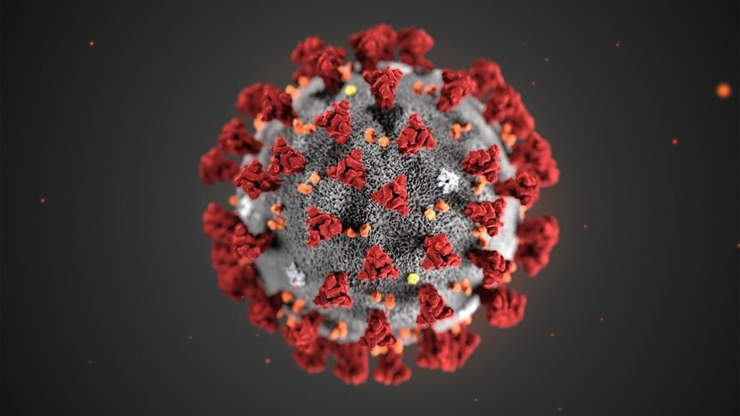
COVID-19
COMMUNITY PLANNING STRATEGIES

Slide 2
NON-PHARMACEUTICAL INTERVENTIONS
Nonpharmaceutical Interventions (NPIs) are actions, apart from getting vaccinated and taking medicine, that people and communities can take to help slow the spread of illnesses like pandemic influenza (flu). NPIs are also known as community mitigation strategies. When a new flu virus spreads among people, causing illness worldwide, it is called pandemic flu. Because a pandemic flu virus is new, the human population has little or no immunity against it. This allows the virus to spread quickly from person to person worldwide. NPIs are among the best ways of controlling pandemic flu when vaccines are not yet available.

Slide 3
DISPOSITION OF TRAVELERS
TO DATE, THE UNCAS HEALTH DISTRICT HAS BEEN NOTIFIED OF 24 TRAVELERS REQUIRING MONITORING.
Emails alert UHD about traveler on a Secure platform
Traveler information is reviewed and documented
UHD assumes responsibility for monitoring
UHD reports back to CT DPH any problems with contact information or changes of jurisdiction.
UHD completes 14 days of monitoring and provides a letter to the traveler.

Slide 4
FAMILIES AND HOUSEHOLDS
• Meet with household members, other relatives, and friends to discuss what should be done if a pandemic occurs and what the needs of each person will be.
• Discuss ways to care for those at greater risk for serious complications, if the services they rely on aren’t available.
• If your neighborhood has a website or social media page, consider joining it to stay connected to neighbors, information, and resources.
• Identify organizations in your community that can offer assistance. Consider including organizations that provide mental health or counseling services, food, and other supplies.
• Create an emergency contact list. Ensure that your household has a current list of emergency contacts for family, friends, neighbors, carpool drivers, health care providers, teachers, employers, the local public health department, and other community resources.
• Plan to have extra supplies of important items on hand, such as soap, hand sanitizer, tissues, and disposable facemasks.
• Choose a room in your home that can be used to separate sick household members from those who are healthy. If possible, also choose a bathroom for the sick person to use. Plan to clean these rooms daily. Learn how to care for someone at home and how to clean a flu patient’s room.
• Prepare for possible school closures, identifying alternative childcare.

Slide 5
SCHOOLS
Review, update, and implement emergency operations plans (EOPs). This should be done in collaboration with the Uncas Health District and other relevant partners. Focus on the components, or annexes, of the plans that address infectious disease outbreaks.

Slide 6
SCHOOLS
Be prepared to allow your staff and students to stay home if someone in their house is sick.
Consider the use of Alternative School Session Planning.
Increase space between people at school to at least 3 feet, as much as possible.
Modify, postpone, or cancel large school events.
Temporarily dismiss students attending childcare facilities, K-12 schools, or institutions of higher education.

Slide 7
BUSINESSES
All employers need to consider how best to decrease the spread of acute respiratory illness and lower the impact of COVID-19 in their workplace in the event of an outbreak in the US. They should identify and communicate their objectives, which may include one or more of the following:
reducing transmission among staff,
(b) protecting people who are at higher risk for adverse health complications,
(c) maintaining business operations, and
(d) minimizing adverse effects on other entities in their supply chains.

Slide 8
BUSINESSES
Be prepared to allow workers to stay home if someone in their house is sick.
Increase space between people at work to at least 3 feet, as much as possible.
Decrease the frequency of contact among people at work.
Modify, postpone, or cancel large work events. Postpone or cancel non-essential work-related travel.
Employers should plan to monitor and respond to absenteeism at the workplace. Implement plans to continue your essential business functions in case you experience higher than usual absenteeism.
Cross-train personnel to perform essential functions so that the workplace is able to operate even if key staff members are absent.
Assess your essential functions and the reliance that others and the community have on your services or products. Be prepared to change your business practices if needed to maintain critical operations (e.g., identify alternative suppliers, prioritize customers, or temporarily suspend some of your operations if needed).

Slide 9
PERSONAL PRECAUTIONS
Stay home when you are sick.
Cover your coughs and sneezes with a tissue.
Wash your hands often with soap and water for at least 20 seconds. Use at least a 60% alcohol-based hand sanitizer if soap and water are not available.
Clean frequently touched surfaces and objects. If surfaces are dirty, they should be cleaned using detergent and water prior to disinfection.

Slide 10
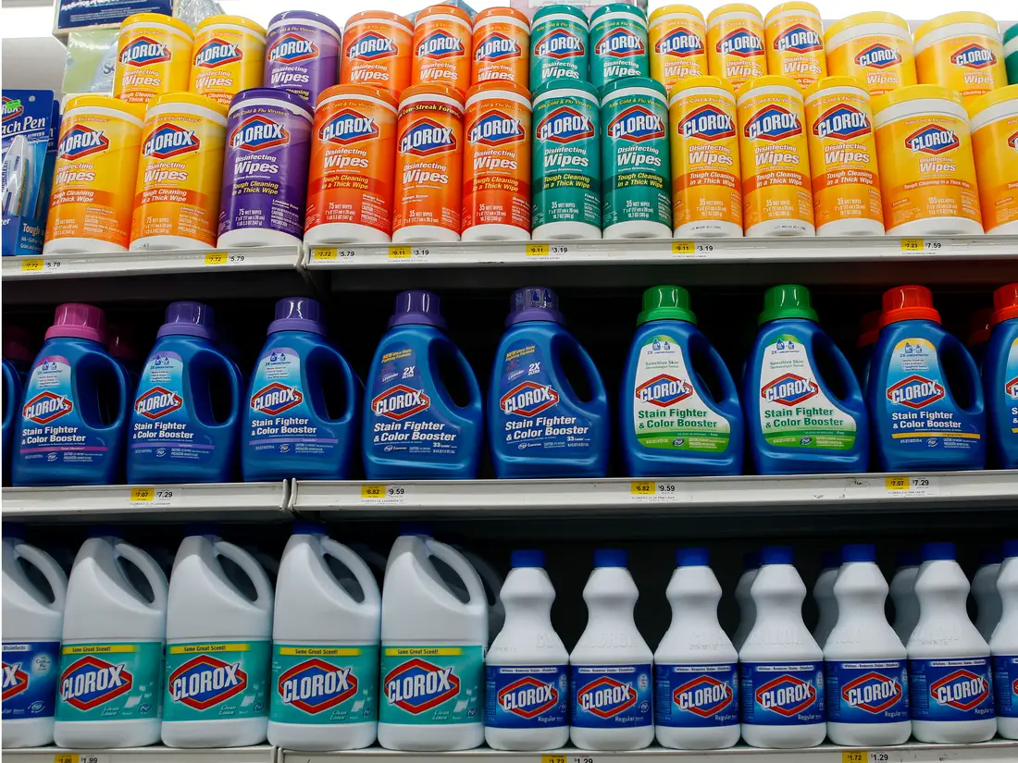
CLEANING PRODUCTS
https://www.americanchemistry.com/Novel-Coronavirus-Fighting-Products-List.pdf
Disinfecting is the responsibility of school custodial staff. They are trained to use disinfectants in a safe and effective
manner and to clean up potentially infectious materials and body fluid spills – blood, vomit, feces, and urine. Contact
your custodian or school nurse if students are ill and your classroom needs cleaning and disinfection.

Slide 11
WHO TO CONTACT
Patrick McCormack, Director of Health
Office: (860) 639-5130
doh@uncashd.org
www.uncashd.org

